Slide 1
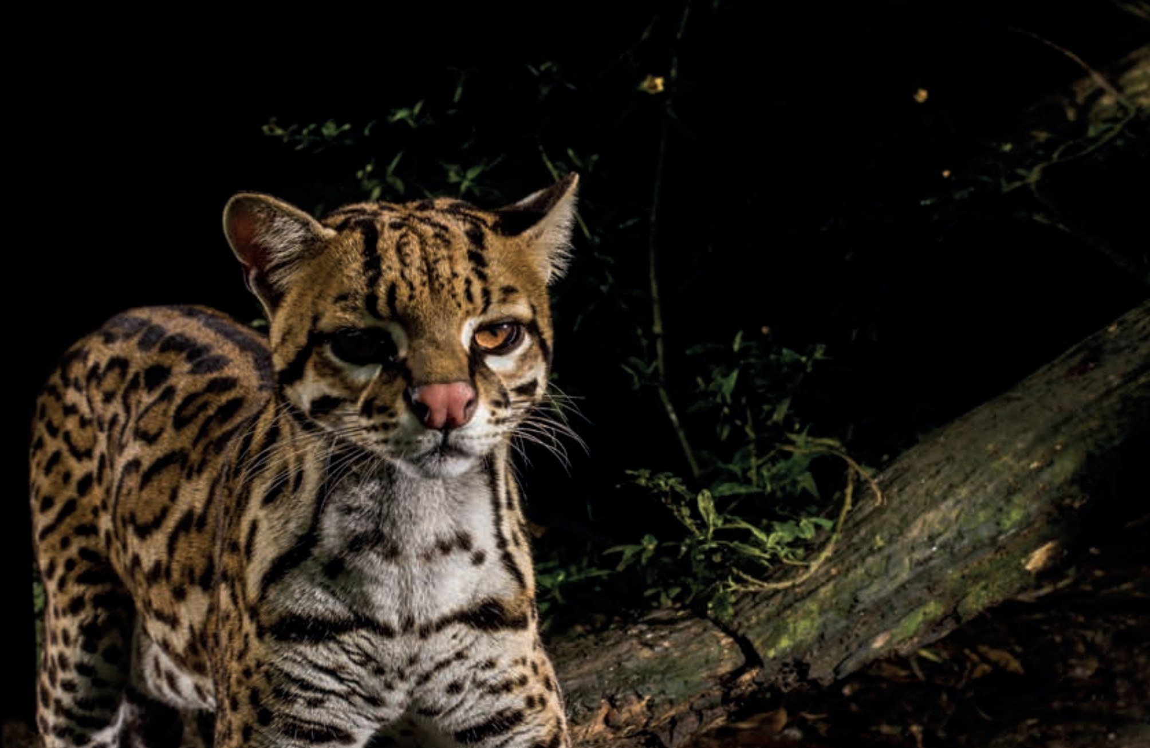
Using Ecological Niche Modeling for designing conservation strategies
A case study of wild felines in Colombia

Slide 2
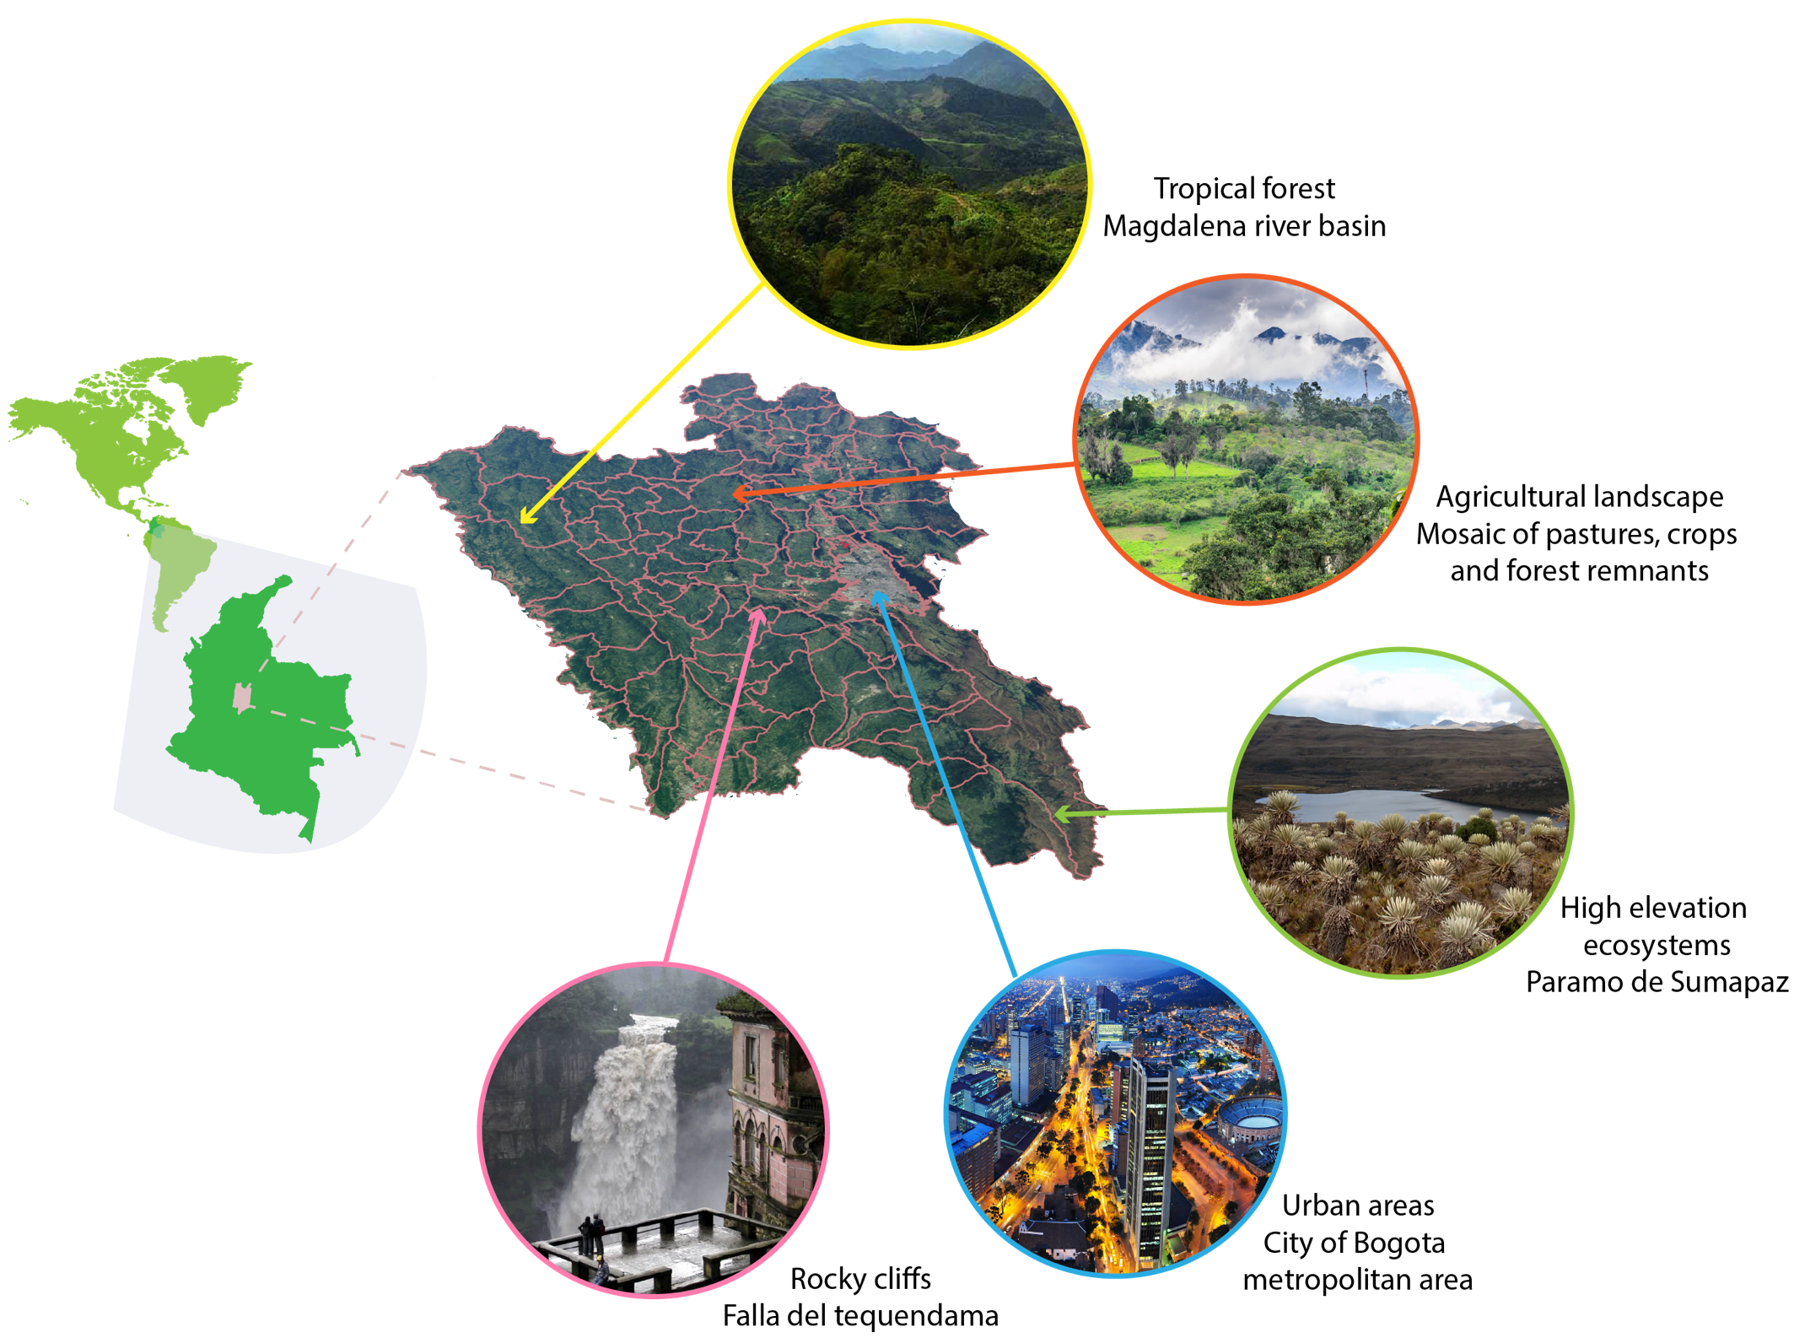

Environmental Authority in charge of the Cundinamarca region, around the nations capital.
Very heterogenic landscape with huge anthropogenic impacts
Population
Bogota metropolitan area:
9 million people
Other municipalities:
2.8 million people
______________________
Total 11.8 million people
Elevation ranges
430 feet- 1,114 feet

Slide 3
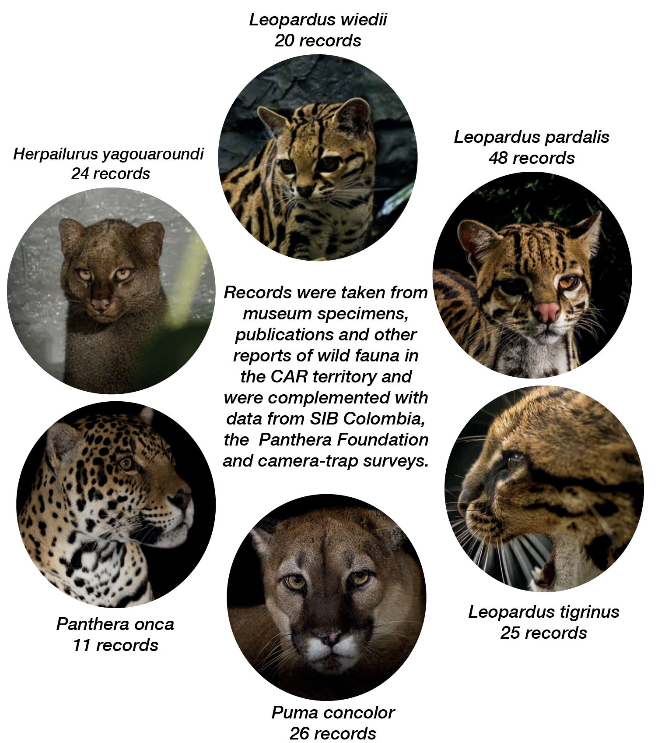
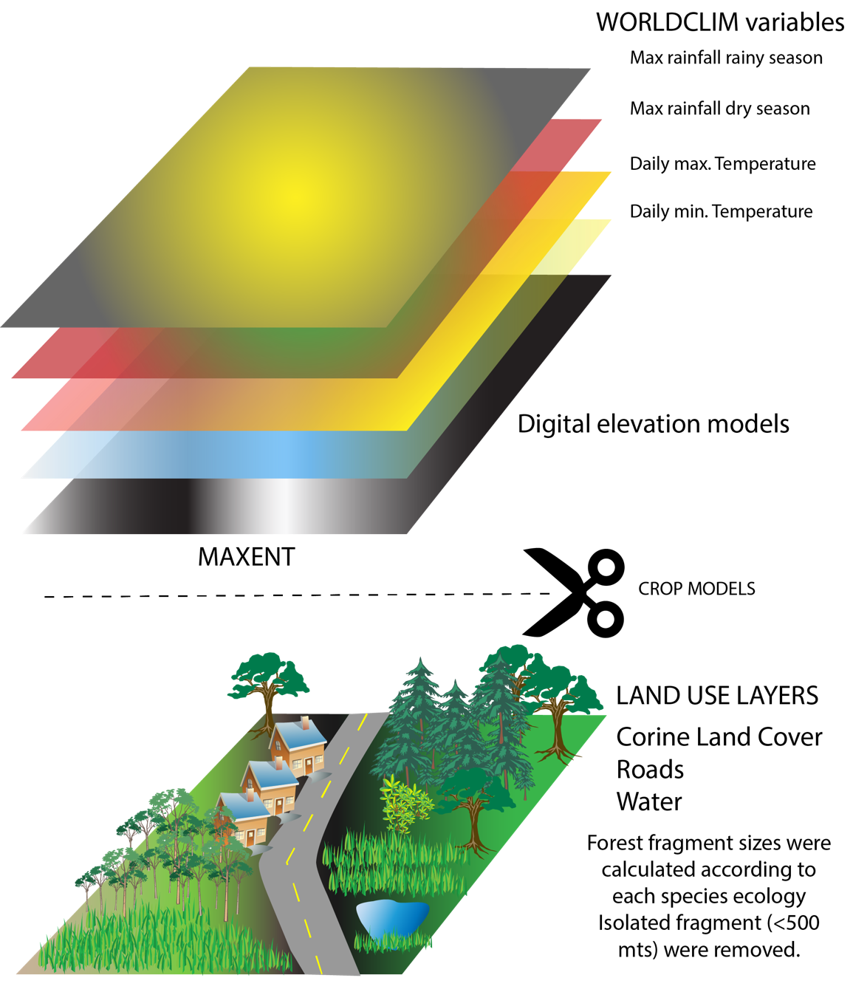
6 species of wild felines have been reported inside CAR territories and camera-trap surveys confirm the presence of 4 of these species in recent years.

Slide 4
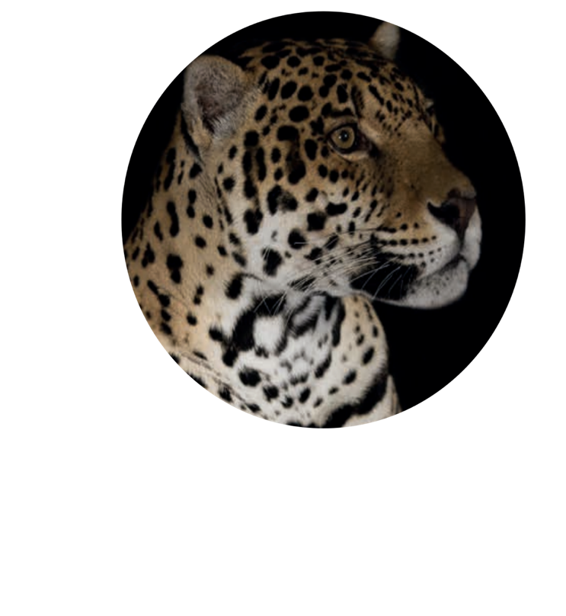
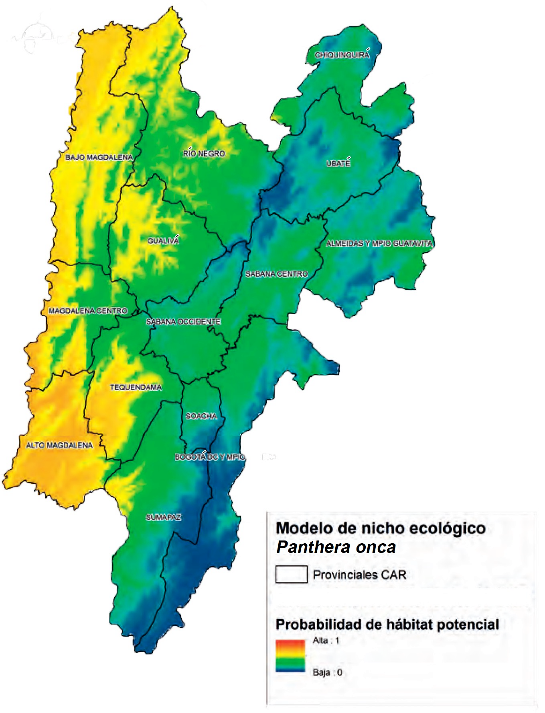
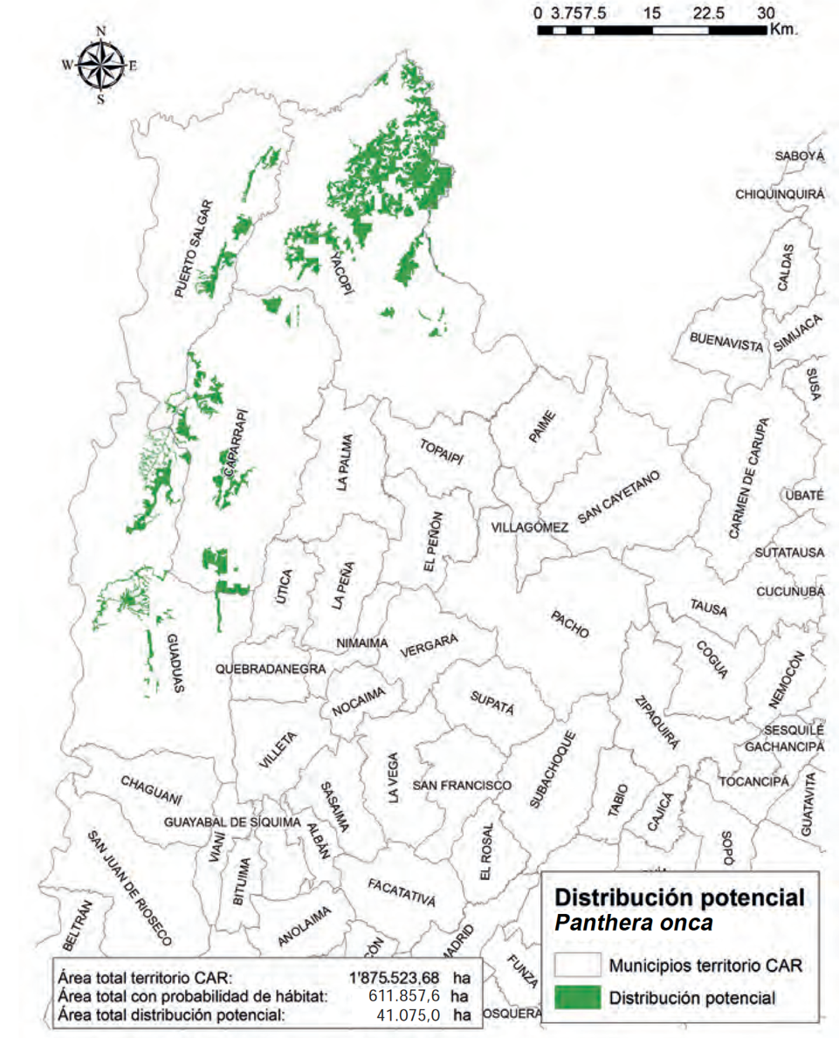
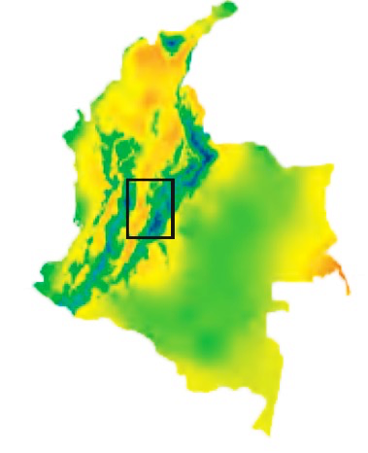
JAGUAR
Temperature and Rainfall
93.3 % potential habitat loss

Slide 5
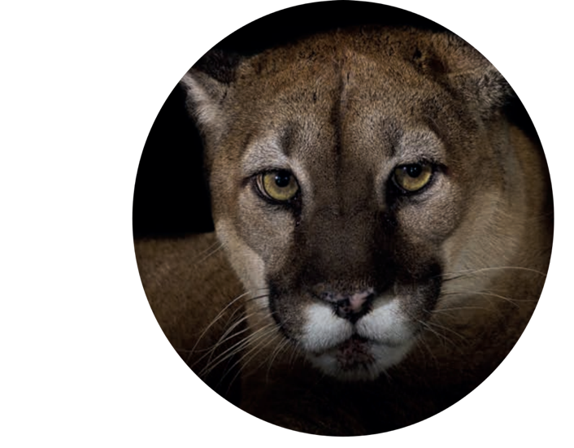
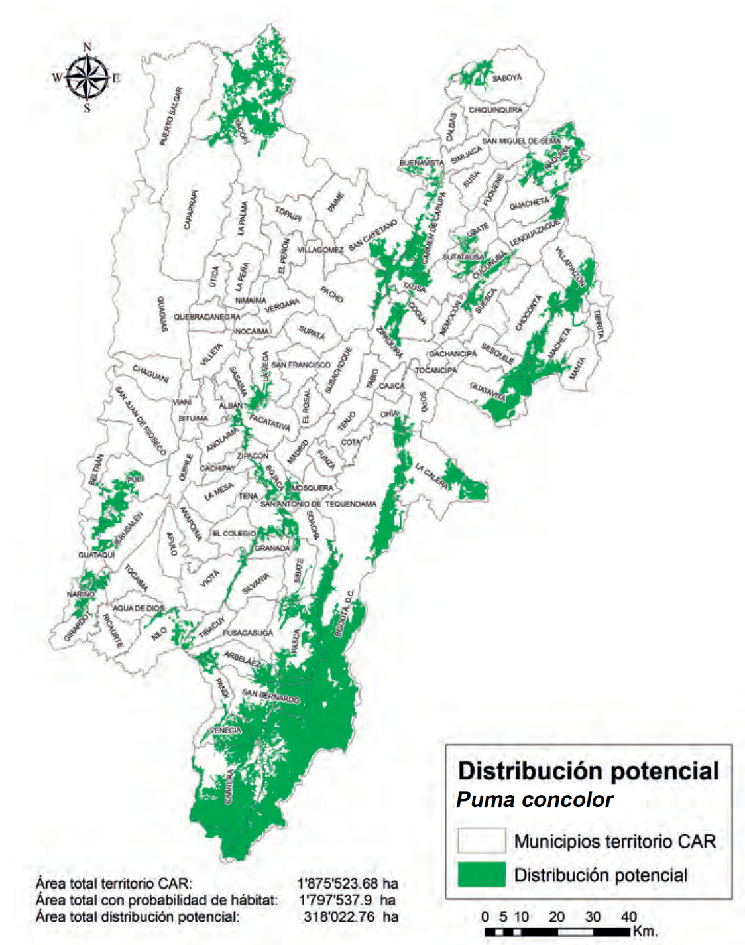
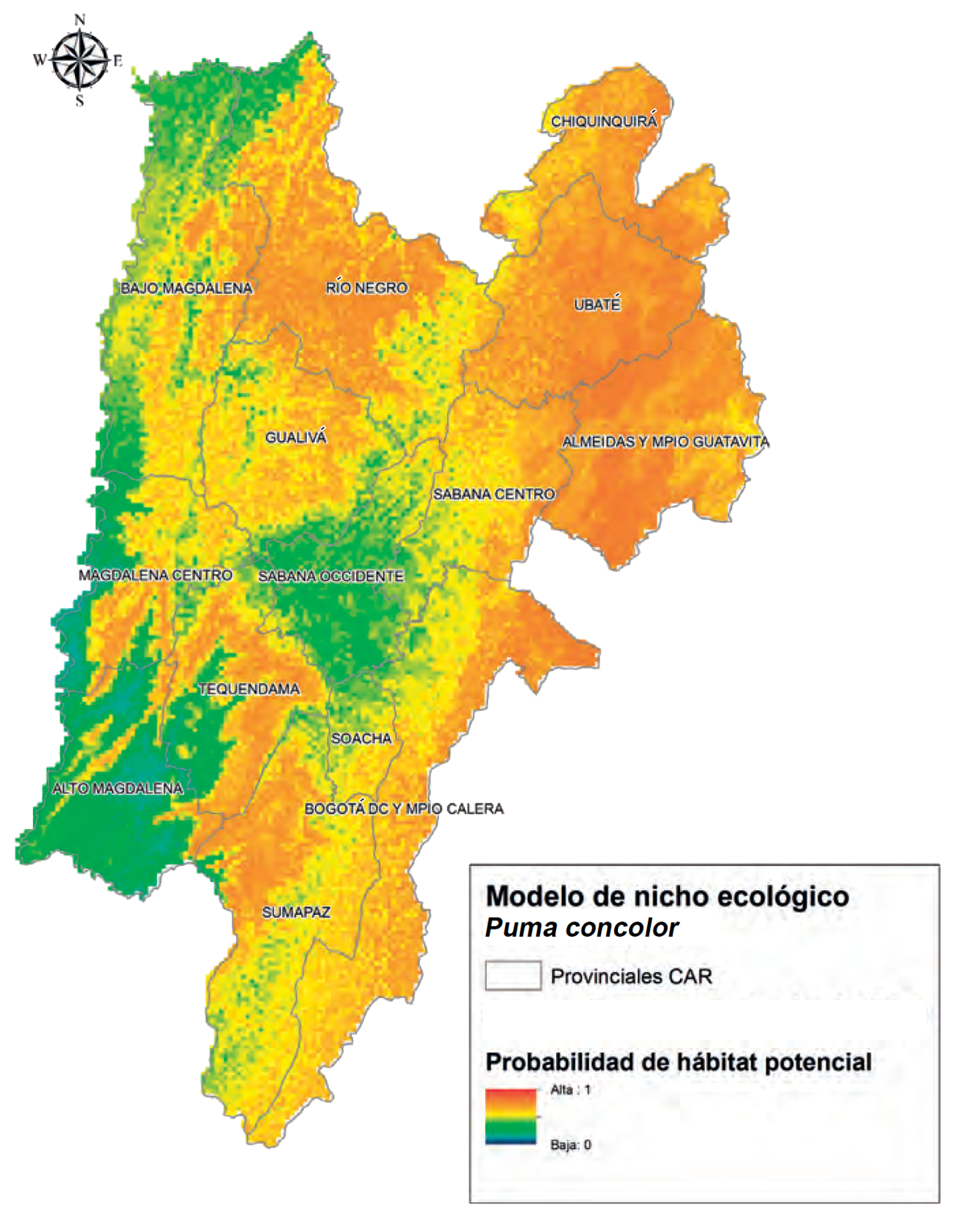
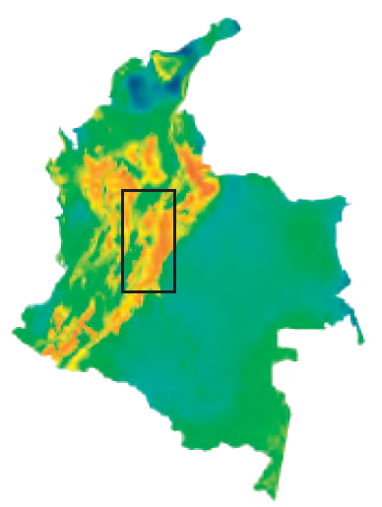
PUMA
Elevation, temperature and rain seasonality
82.3 % potential habitat loss

Slide 6
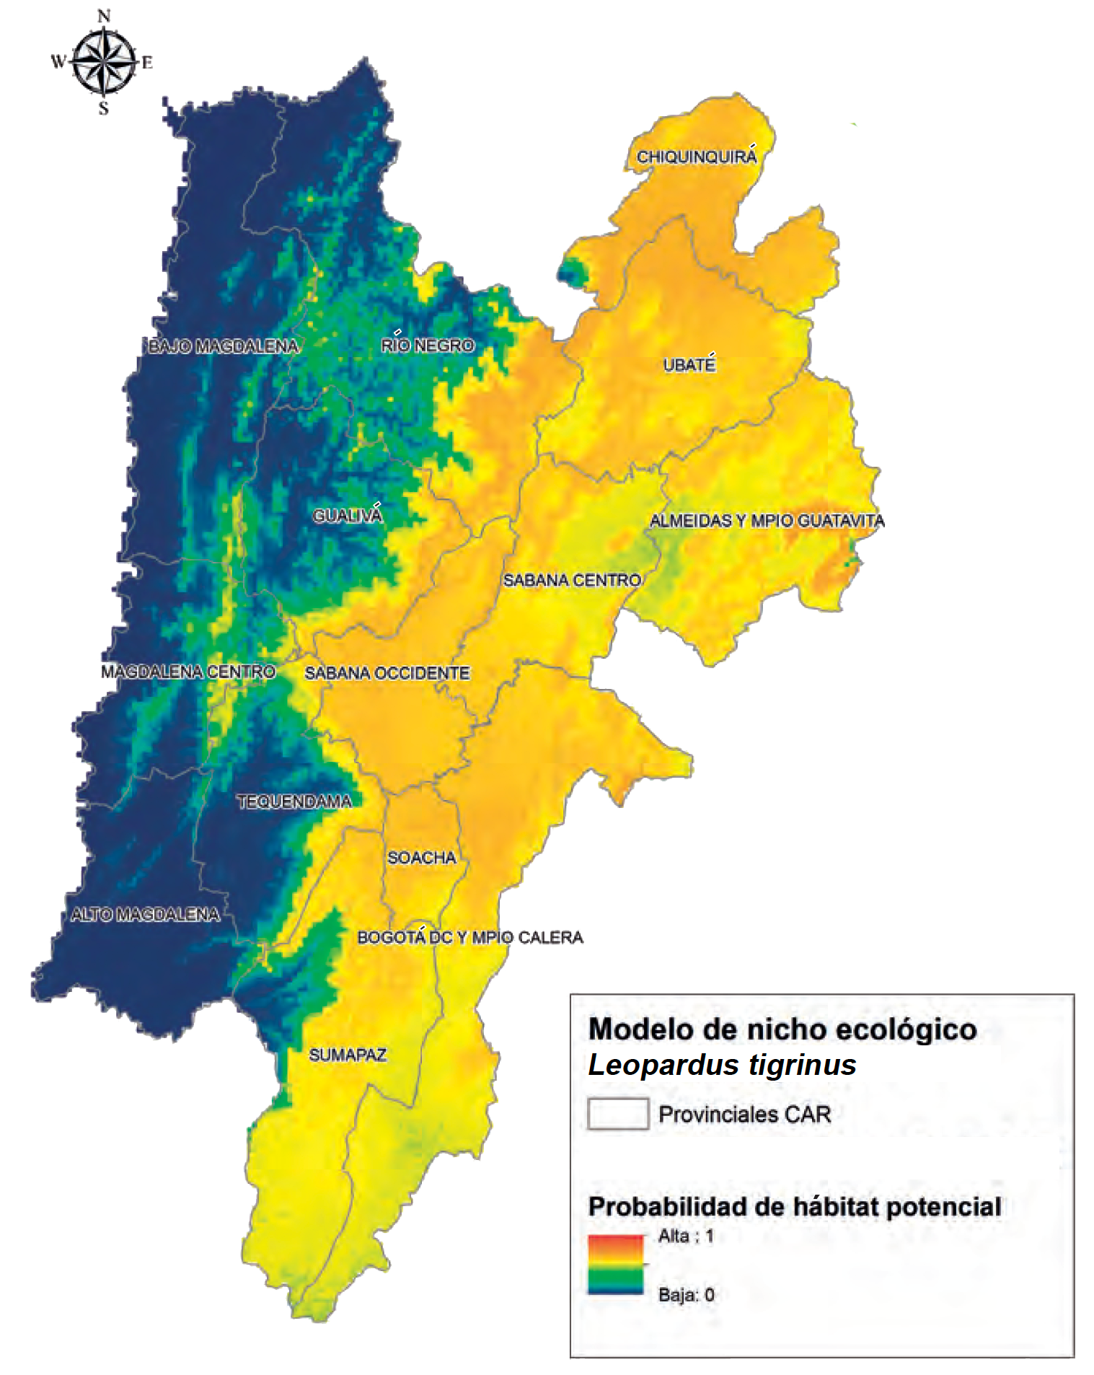
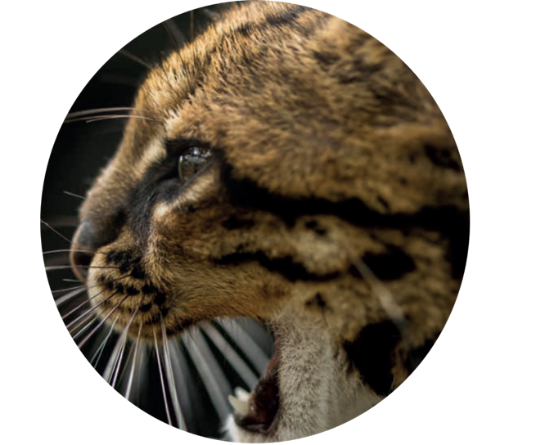
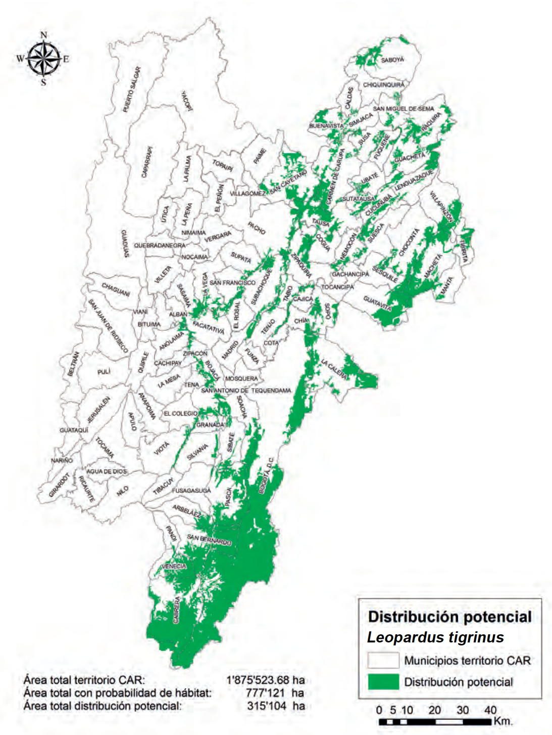
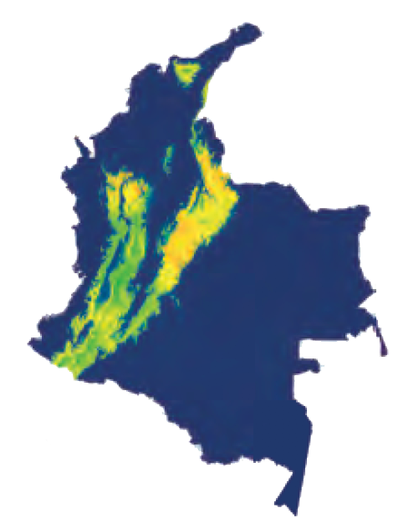
ONCILLA
Elevation and rain seasonality
59.5 % potential habitat loss

Slide 7
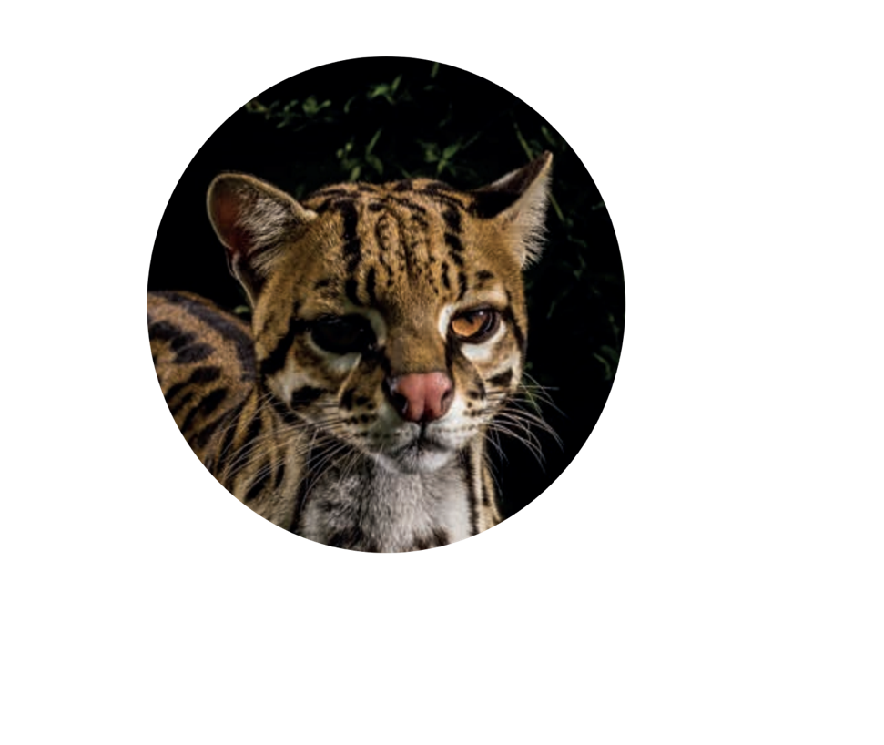
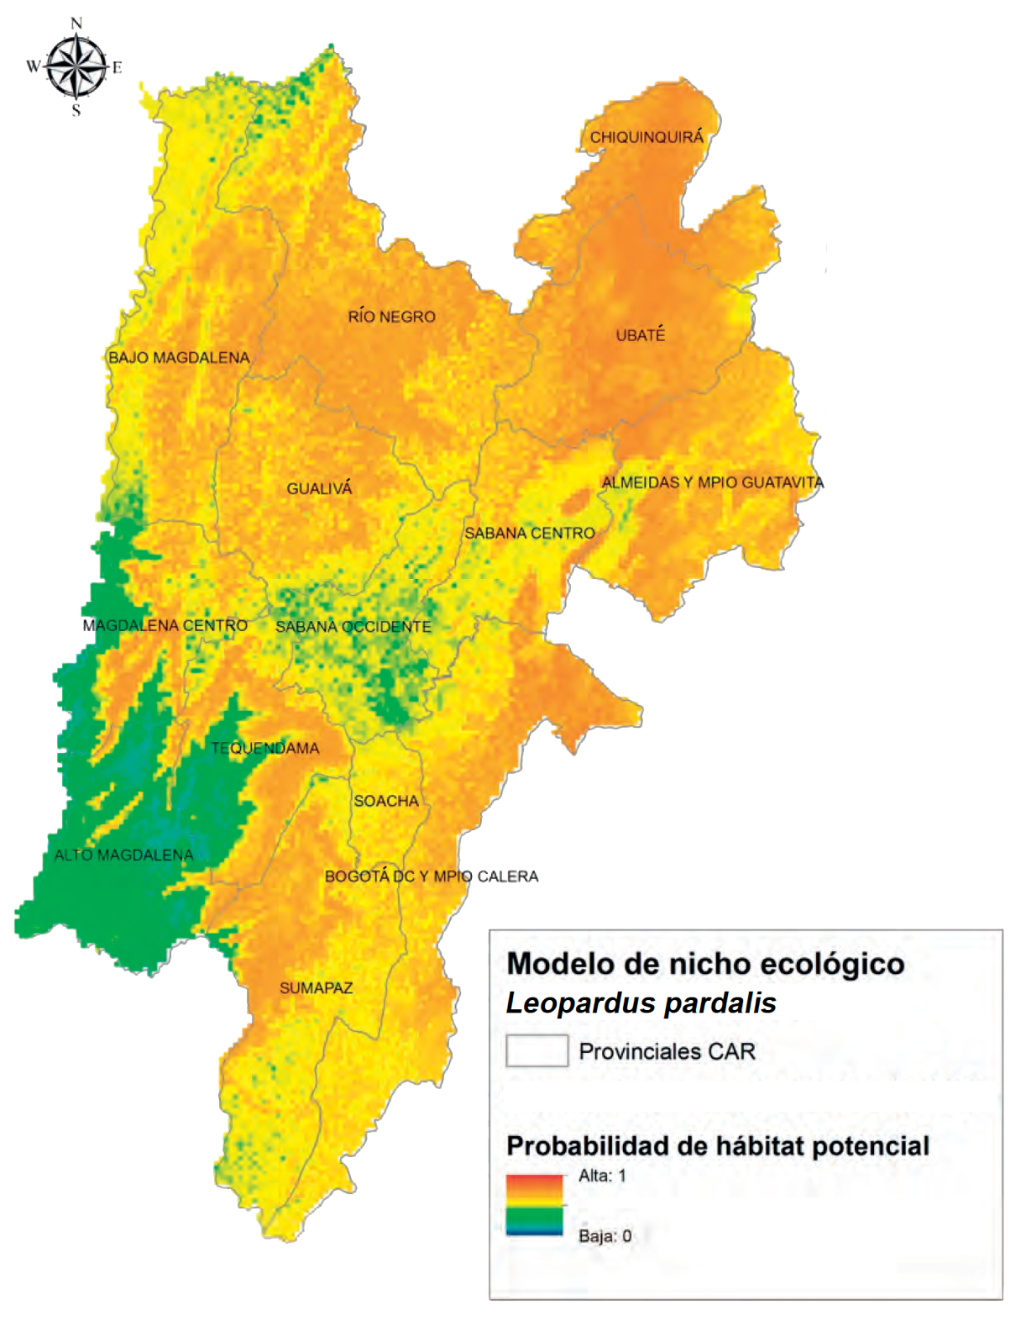
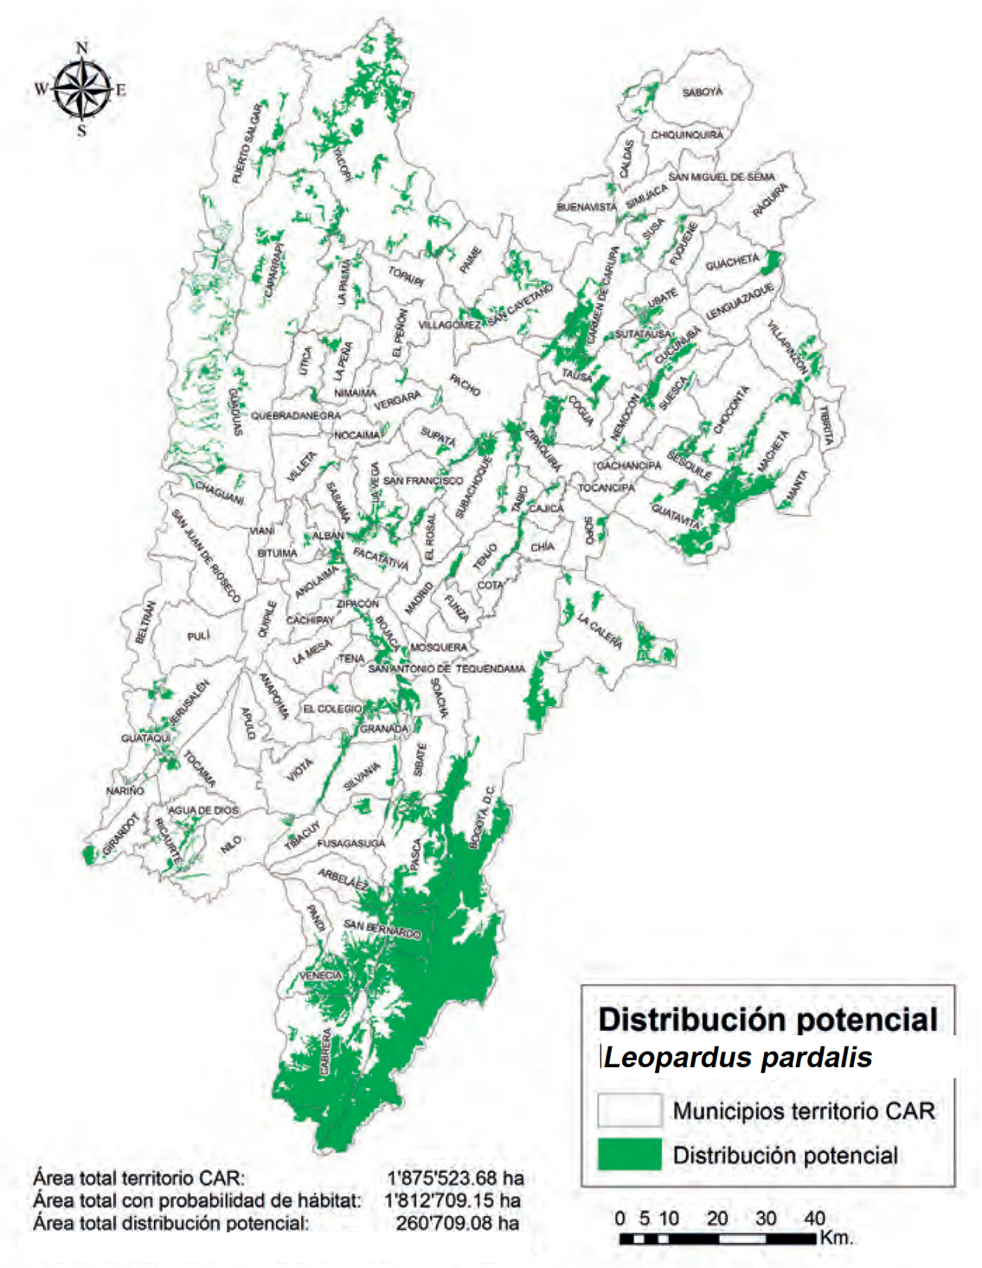
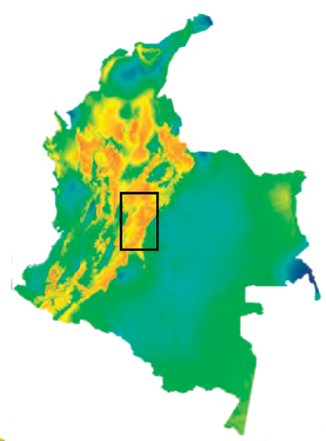
OCELOT
Temperature and elevation
85.6 % potential habitat loss

Slide 8
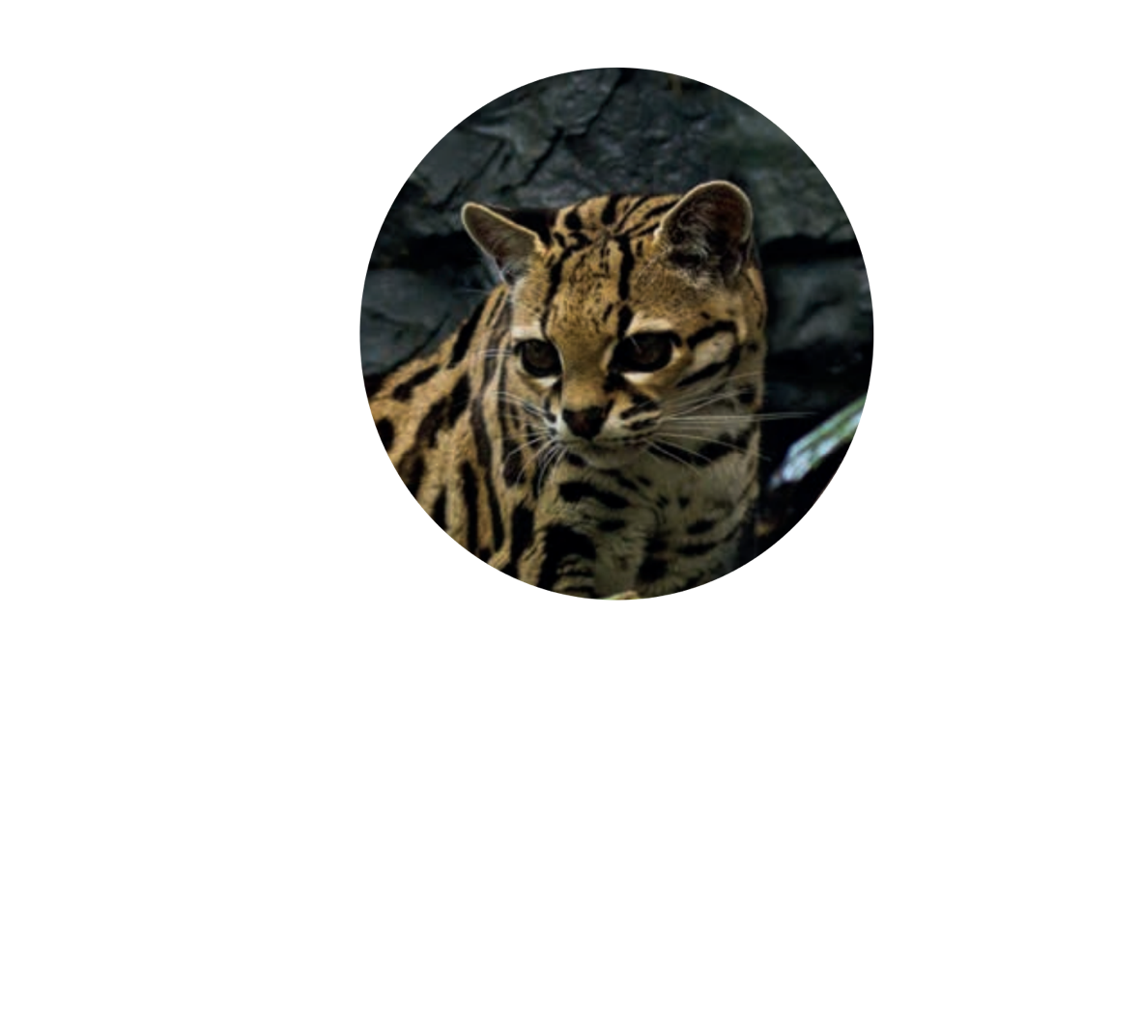
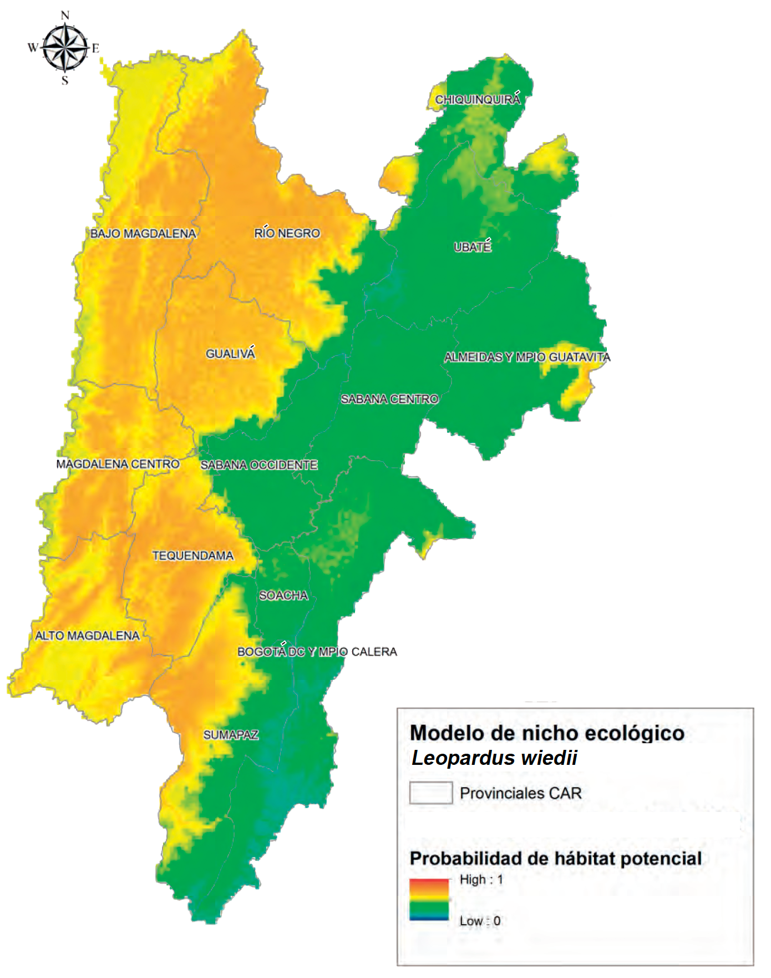
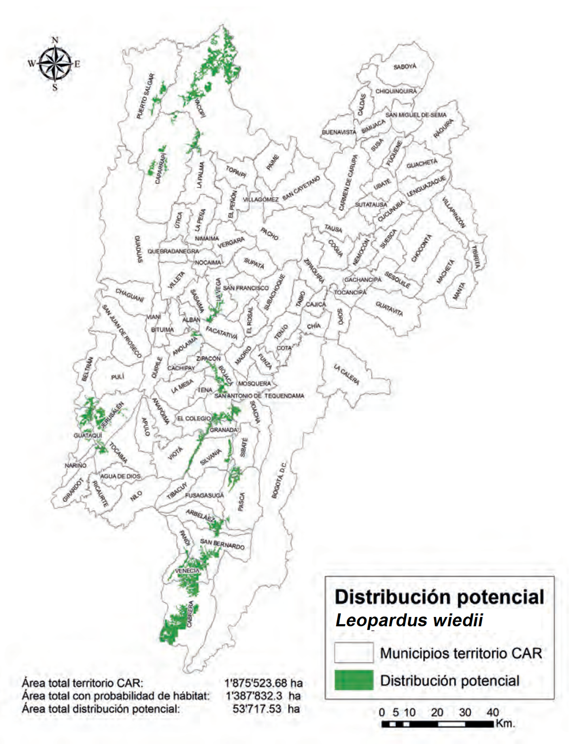
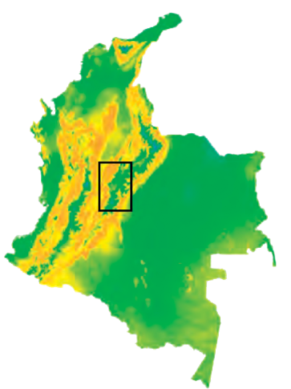
MARGAY
Rainfall and elevation
96.1 % potential habitat loss

Slide 9
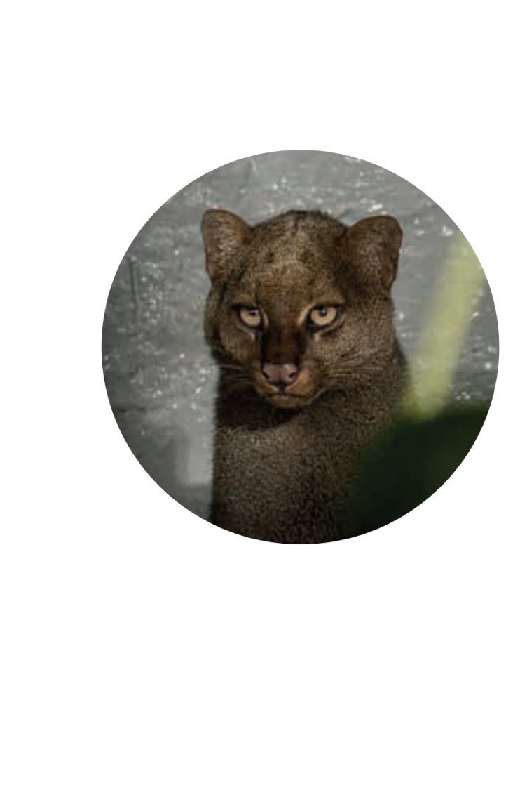
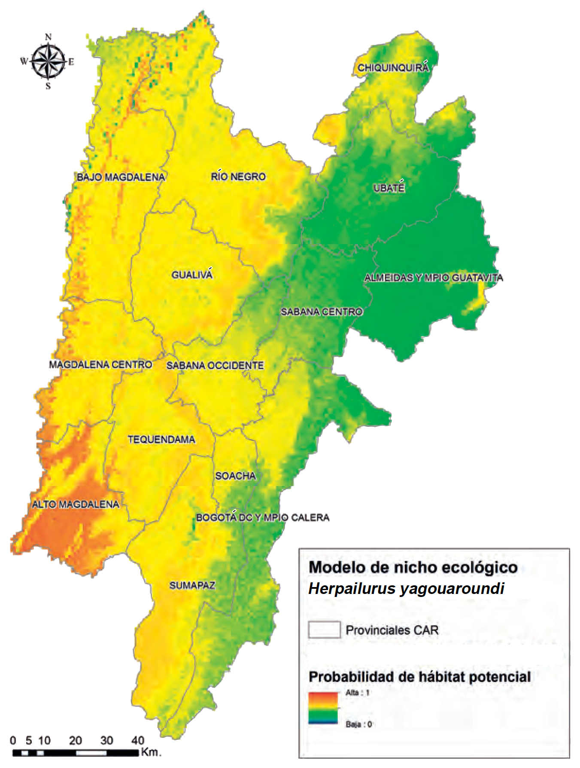
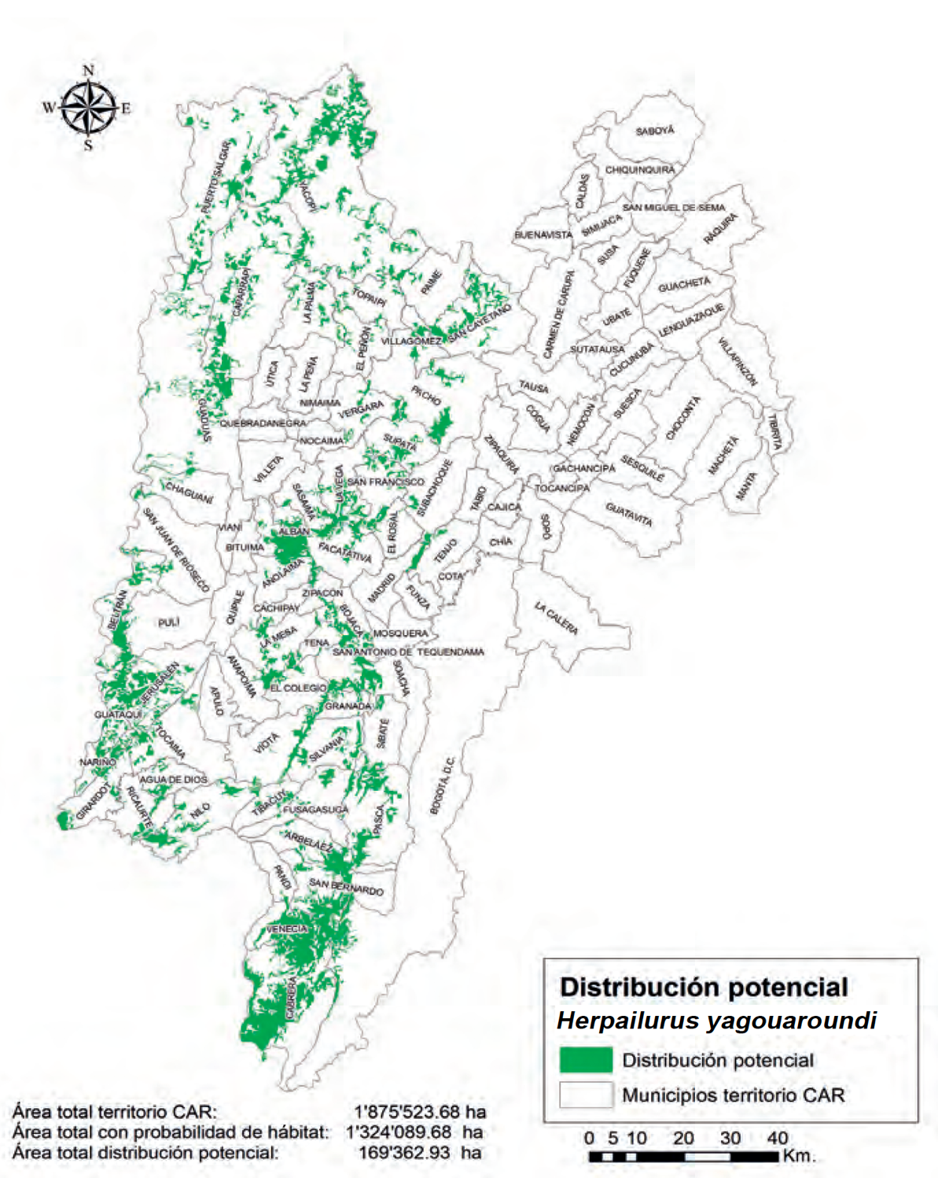
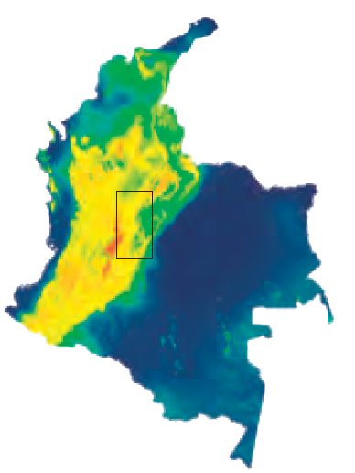
JAGUARUNDI
Elevation and temperature minimum
87.2 % potential habitat loss

Slide 10
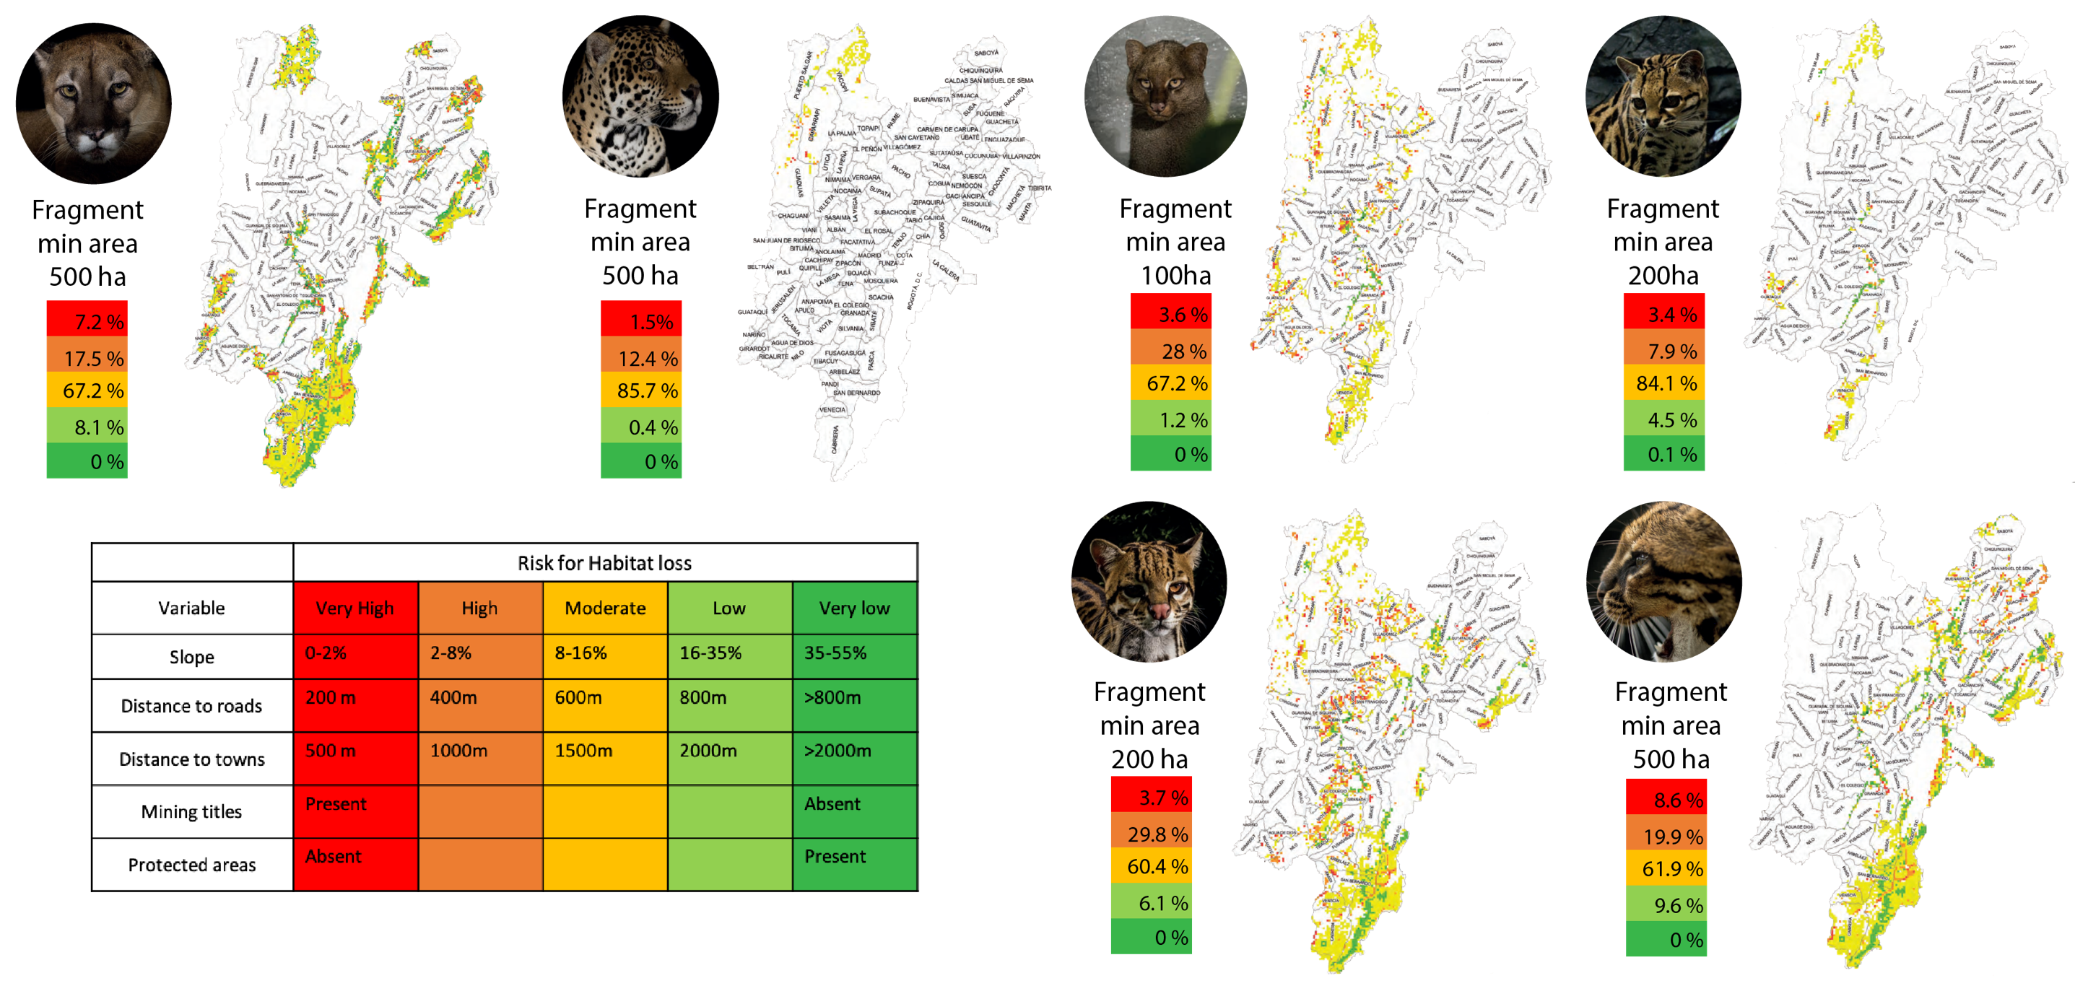
MULTICRITERIA ANALYSIS TO ESTIMATE RISK OF HABITAT LOSS

Slide 11
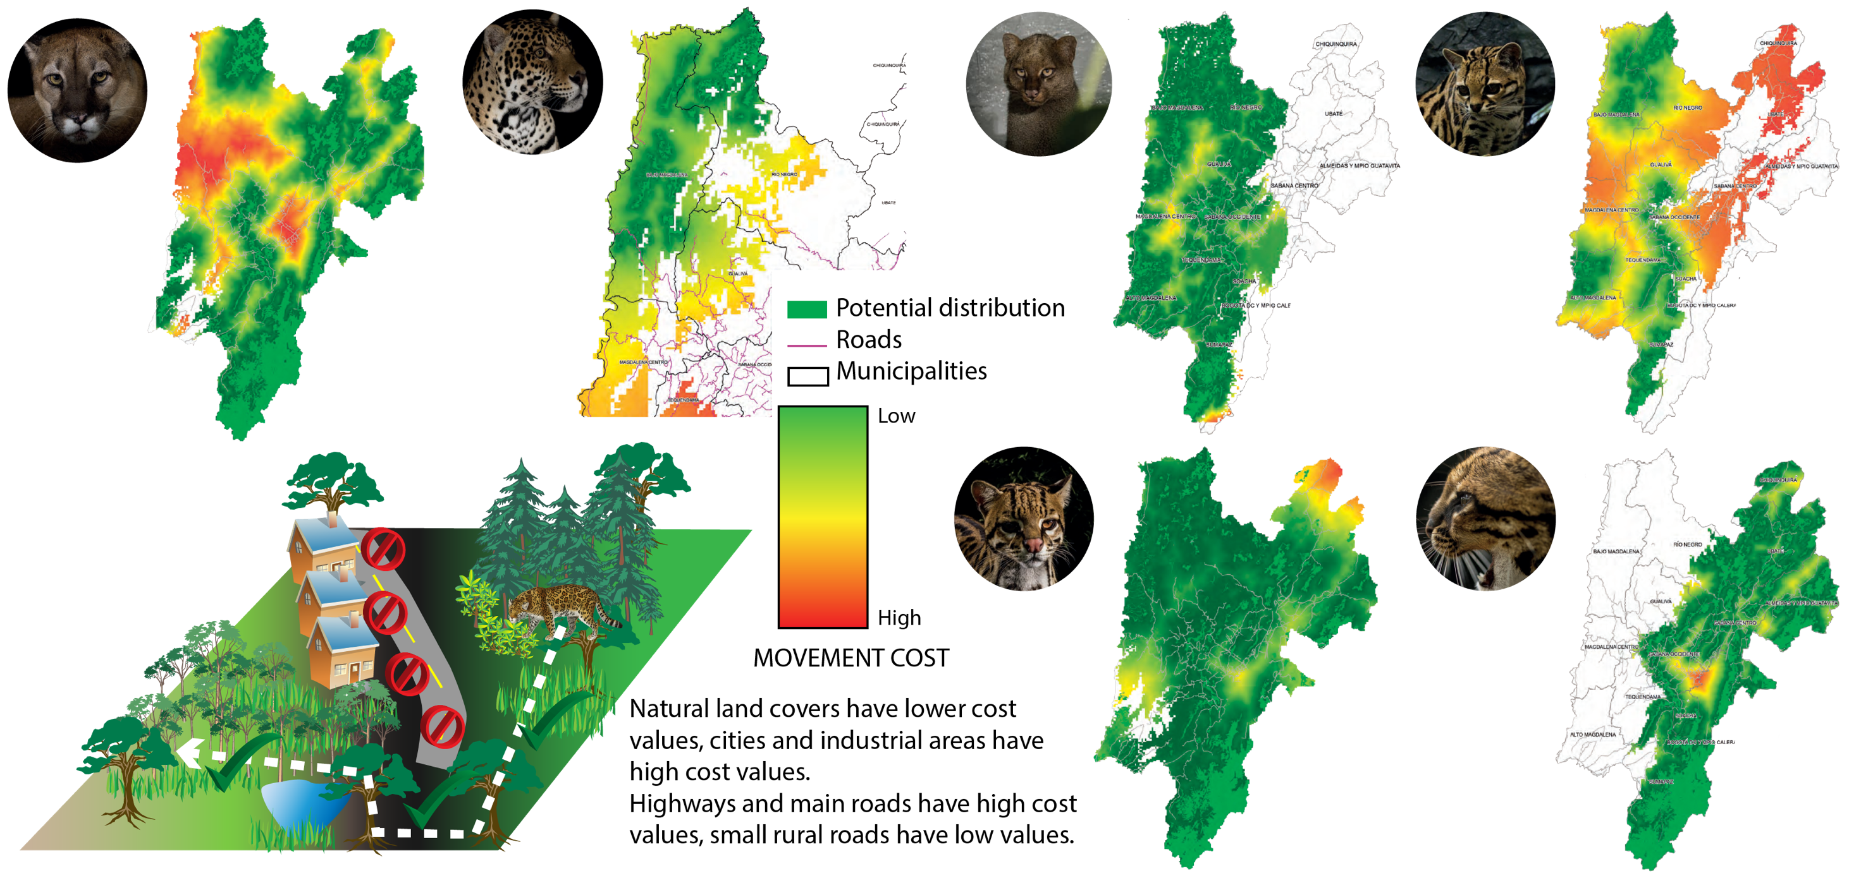
MOVEMENT COST ANALYSIS (Cost-Distance ArcMap)

Slide 12
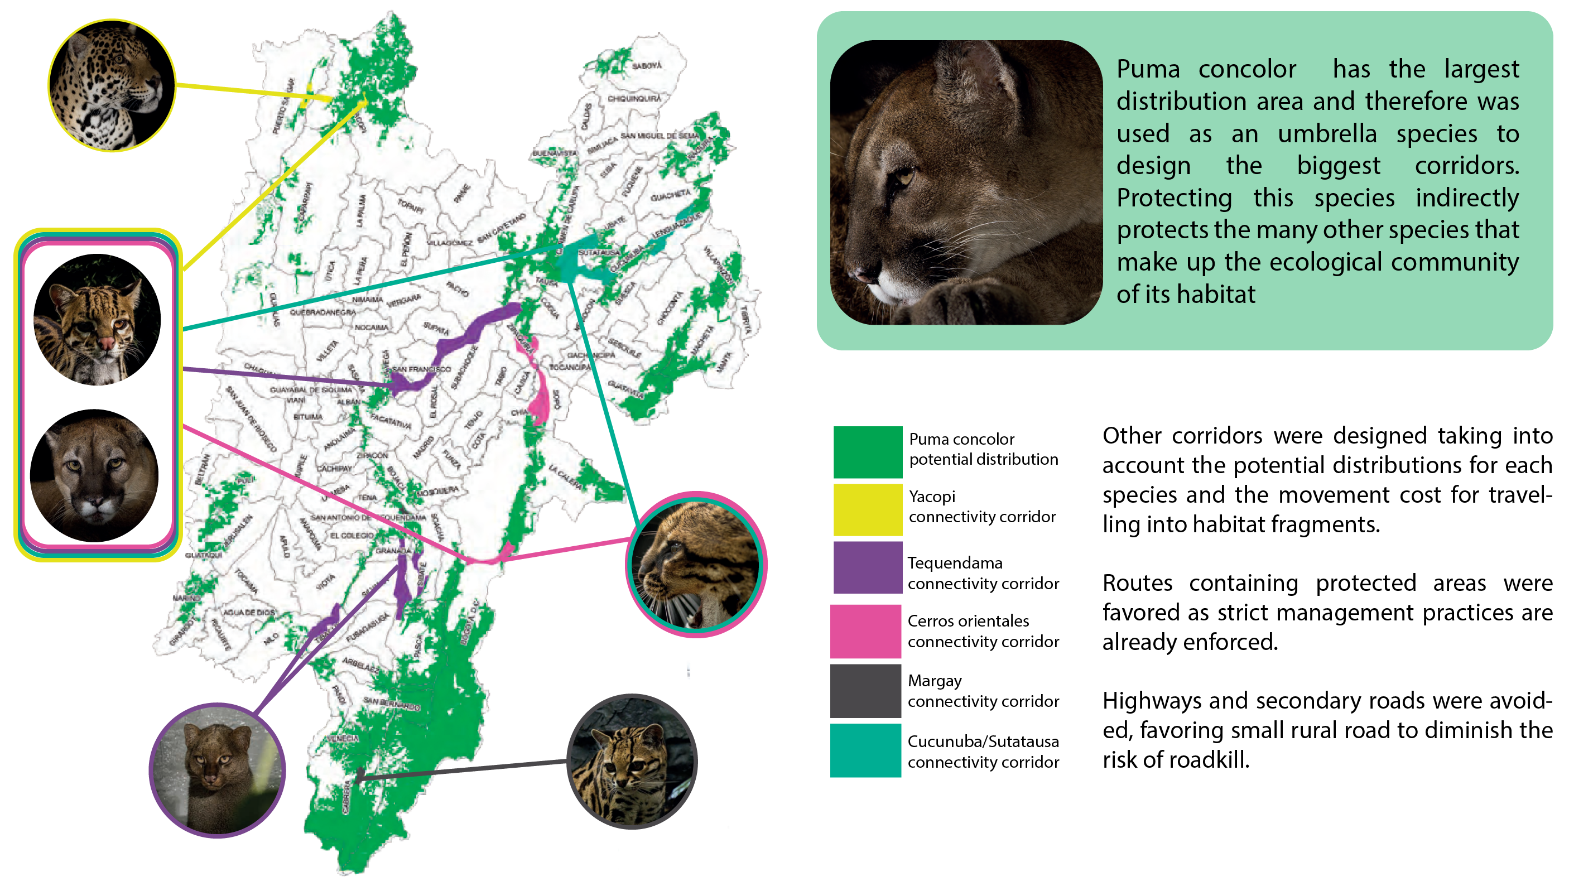
ECOLOGICAL CORRIDOR DESIGN

